Slide 1

CSET 150
Network Design and Management
Evening Masters Edition
Dr. Mahboob Qaosar
Associate Professor, CSE, RU
Week # 2

Slide 2
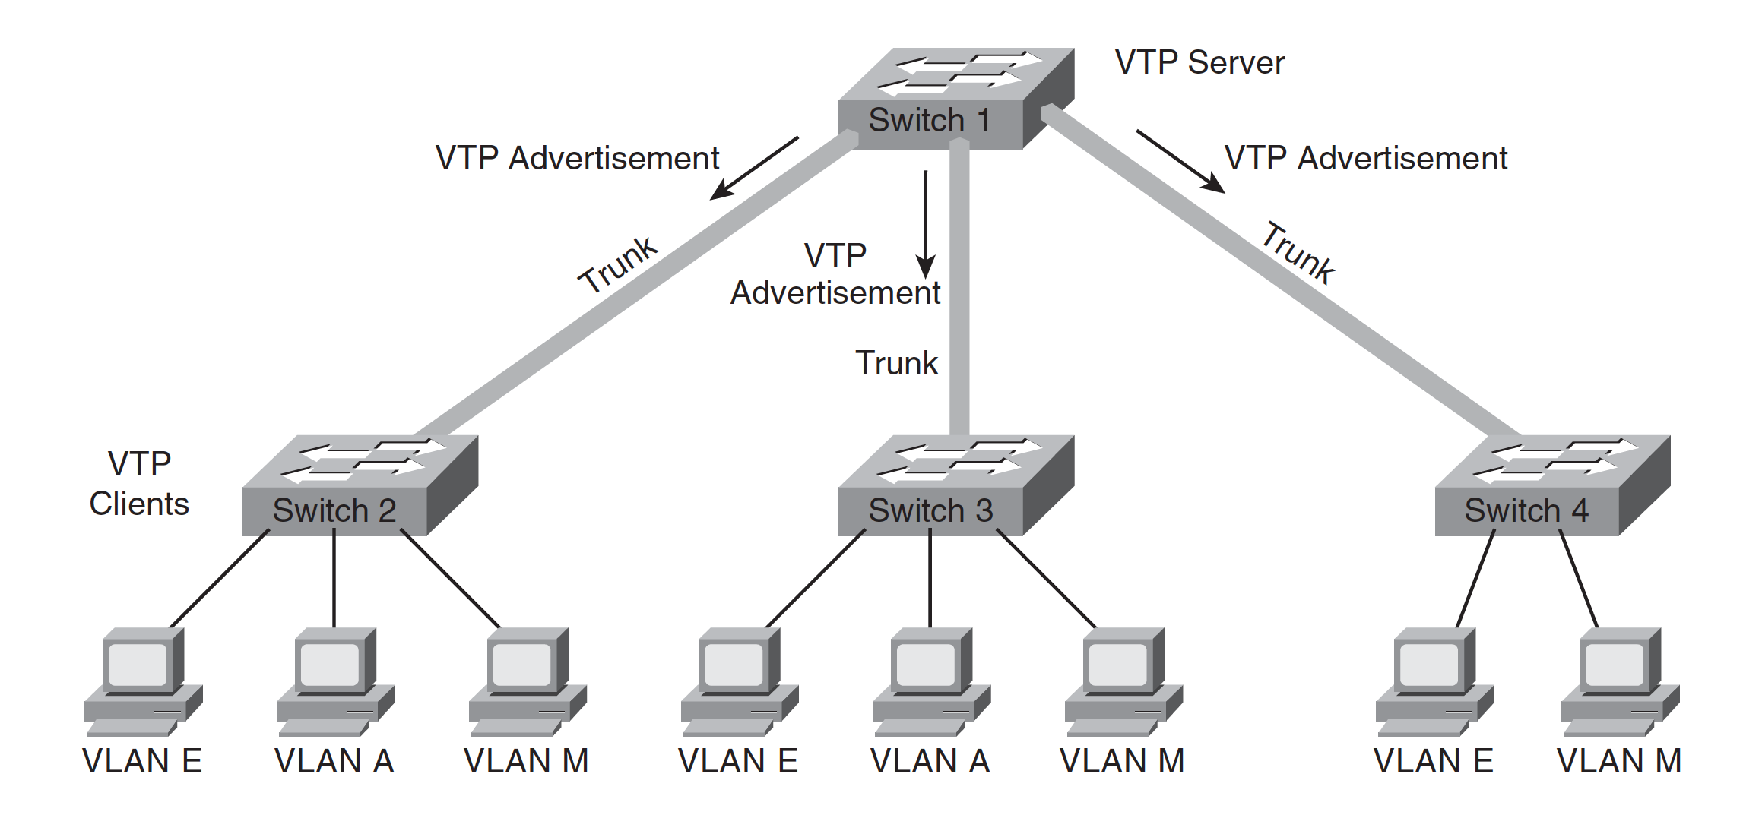
VLAN Trunking Protocol (VTP)
The VLAN Trunking Protocol (VTP) is a Cisco-proprietary Layer 2 protocol that allows easier configuration of VLANs on multiple switches
A switch in a VTP domain (a group of switches communicating with VTP) can be in one of three modes:
server (which is the default mode),
client,
or transparent mode

Slide 3
VLAN Trunking Protocol (VTP)
The VTP server is the one on which you configure the VLANs;
It sends VTP advertisements, containing VLAN configuration information, to VTP clients in the same VTP domain,
VTP advertisements are only sent on trunks.

Slide 4
VLAN Trunking Protocol (VTP)
You cannot create, modify, or delete VLANs on a VTP client;
a VTP client only accepts VLAN configuration information from a VTP server.
A VTP client also forwards the VTP advertisements to other switches.

Slide 5
VLAN Trunking Protocol (VTP)
You can create, modify, or delete VLANs on a switch that is in VTP transparent mode;
This information is not sent to other switches, and the transparent-mode switch ignores advertisements from VTP servers
But does pass them on to other switches.

Slide 6
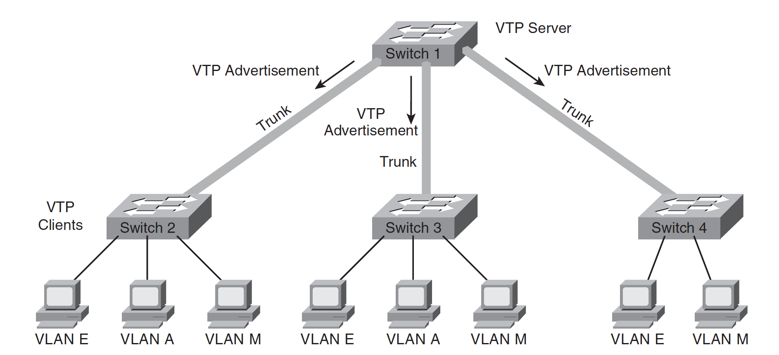
VTP Pruning
VTP pruning (trim/ reducing) is a VTP feature that helps reduce the amount of flooded traffic that is sent on the network.
…, the switches communicate with each other to find out which switches have ports in which VLANs;
switches that have no ports in a particular VLAN (and have no downstream switches with ports in that VLAN) do not receive that VLAN's traffic

Slide 7
Inter-VLAN Routing
But how do networked devices on different VLANs communicate with each other?
Just like devices on different LANs, those on different VLANs require a Layer 3 mechanism (a router or a Layer 3 switch) to communicate with each other.

Slide 8
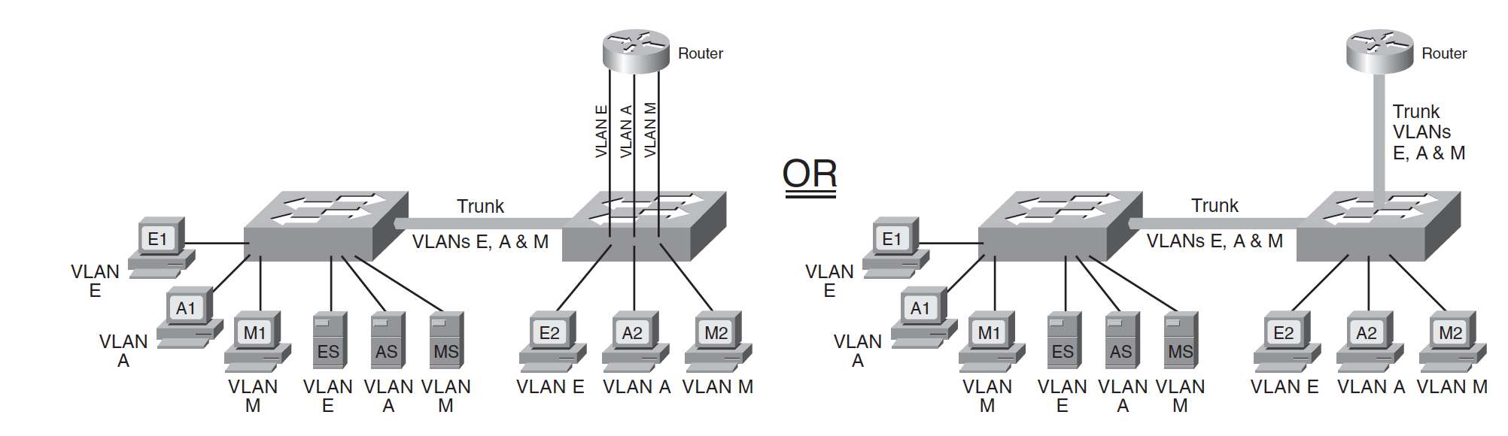
Inter-VLAN Routing
A Layer 3 device can be connected to a switched network in two ways:
by using multiple physical interfaces or
through a single interface configured as a trunk.
The diagram on the left in this figure illustrates a router with three physical connections to the switch; each physical connection carries traffic from only one VLAN.

Slide 9
Multilayer Switching
The 2 different ways that Layer 3 switching is implemented within Cisco switches:
Multilayer switching and
Cisco Express Forwarding

Slide 10
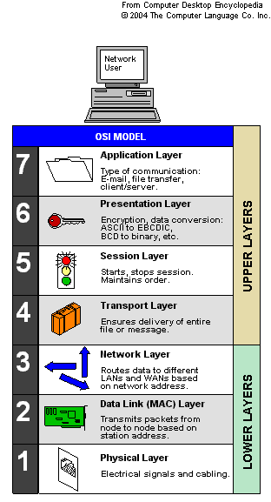
Multilayer switching
Multilayer switching… MLS
allows switching to take place at different protocol layers.
Switching can be performed only on Layers 2 and 3,
or it can also include Layer 4.
MLS is based on network flows.
A network flow is a unidirectional sequence of packets between a source and a destination.

Slide 11
MULTILAYER SWITCHING
The three major components of MLS are as follows:
MLS Route Processor (MLS-RP)
The MLS-enabled router that performs the traditional function of routing between subnets
MLS Switching Engine (MLS-SE)
The MLS-enabled switch that can offload some of the packet-switching functionality from the MLS-RP
Multilayer Switching Protocol (MLSP)
Used by the MLS-RP and the MLS-SE to communicate with each other

Slide 12
MULTILAYER SWITCHING
MLS can be implemented in the following two ways:
Within a Catalyst switch
Here both the MLS-RP and the MLS-SE are resident in the same chassis.
An example of an internal MLS-RP is a Route Switch Module (RSM) installed in a slot of a Catalyst 5500 Series switch.
Using a combination of a Catalyst switch and an external router
An example of a router that can be an external MLS-RP router is a Cisco 3600 Series router with the appropriate IOS software release and with MLS enabled.

Slide 13
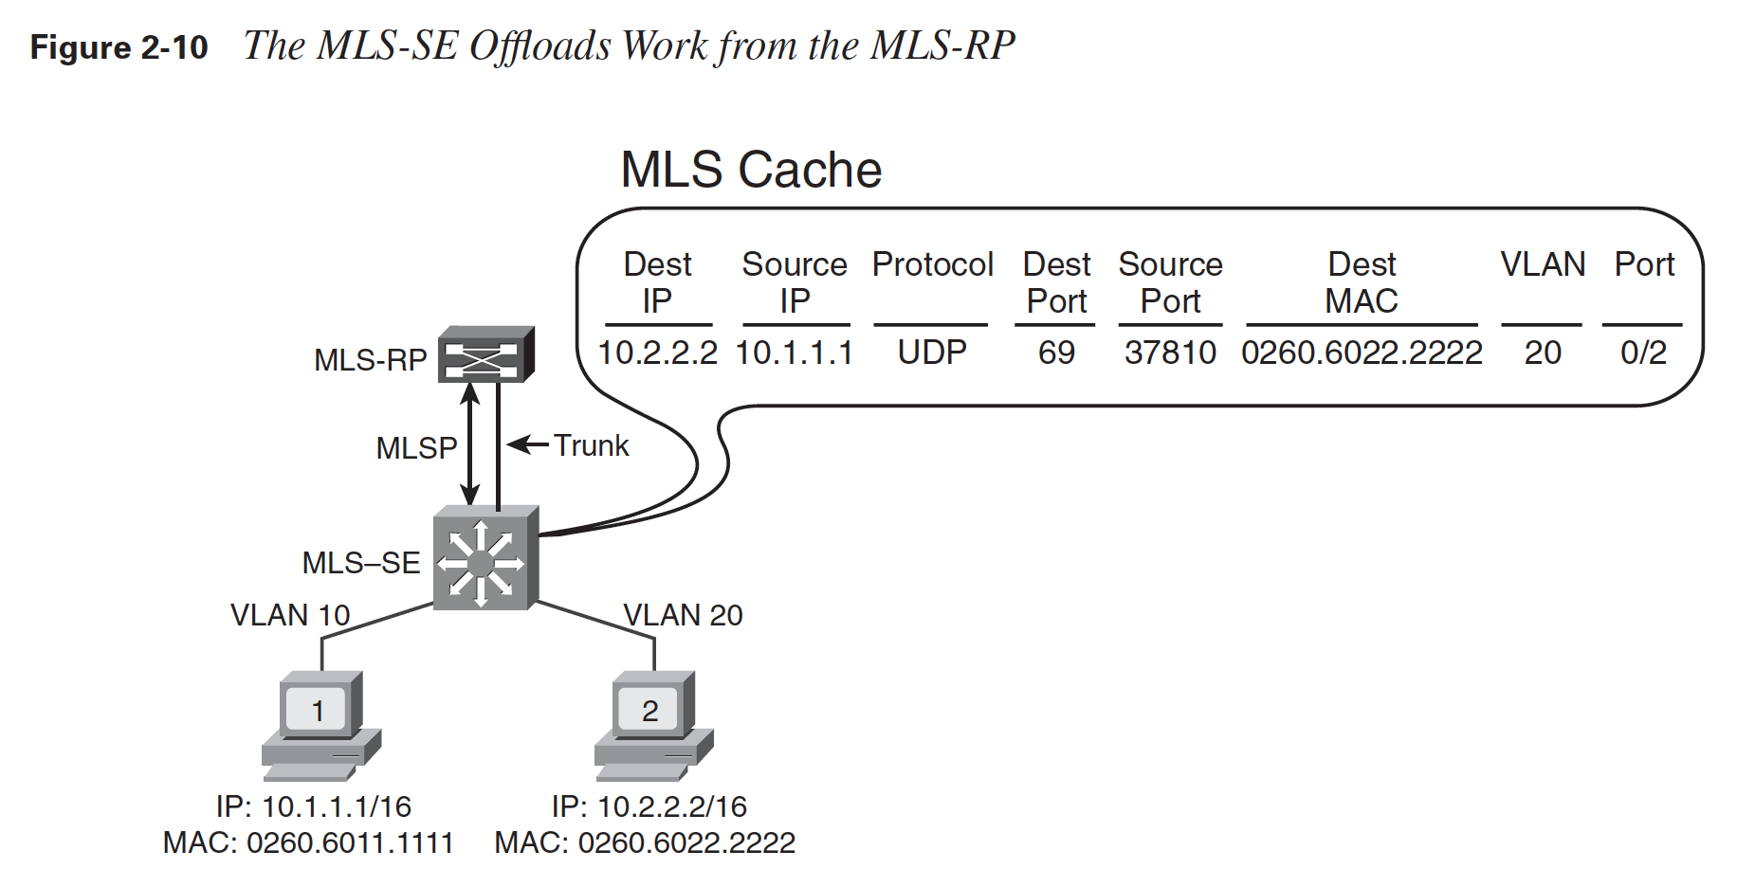
MULTILAYER SWITCHING
MLS Route Processor (MLS-RP)
MLS Switching Engine (MLS-SE)
Multilayer Switching Protocol (MLSP)

Slide 14
Cisco Express Forwarding
Cisco Express Forwarding (CEF)
Aims to speed the data routing and forwarding process in a network.
However, the two methods use different approaches.
CEF uses two components to optimize the lookup of the information required to route packets:
Forwarding Information Base (FIB) for the Layer 3 information and
Adjacency table for the Layer 2 information

Slide 15
Switching Security
Two types of switch security as follows:
Catalyst native security 🡪 Those features built into the switch itself
Catalyst hardware security 🡪 Features of hardware that can be installed in the switch

Slide 16
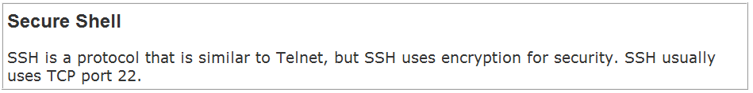
Catalyst Native Security
Cisco switches have many native attributes that can be used to secure a network.
Some attributes are related to the secure management of the switch itself.
One example is the use of secure shell (SSH), rather than Telnet, when remotely managing the switch.
Another example is disabling unused switch ports so that the network cannot be accessed through them.

Slide 17
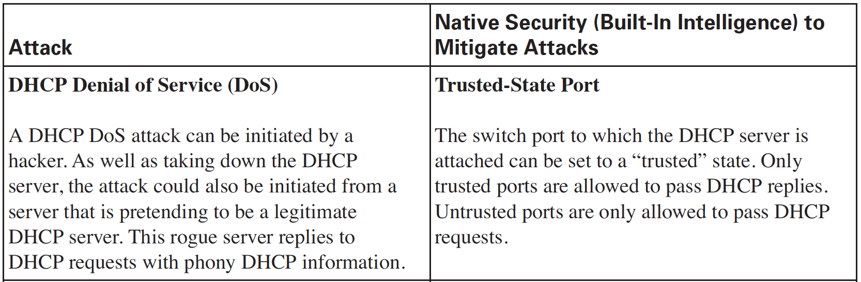
Catalyst Native Security
Examples of Built-In Intelligence to Mitigate Attacks

Slide 18
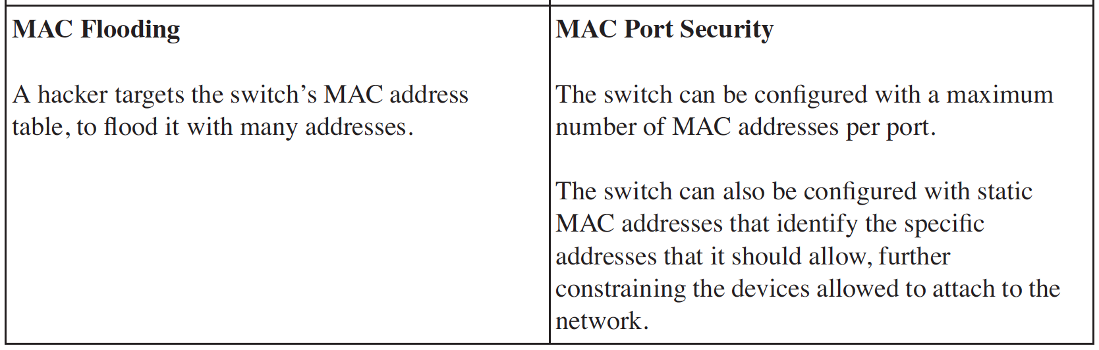
Catalyst Native Security

Slide 19
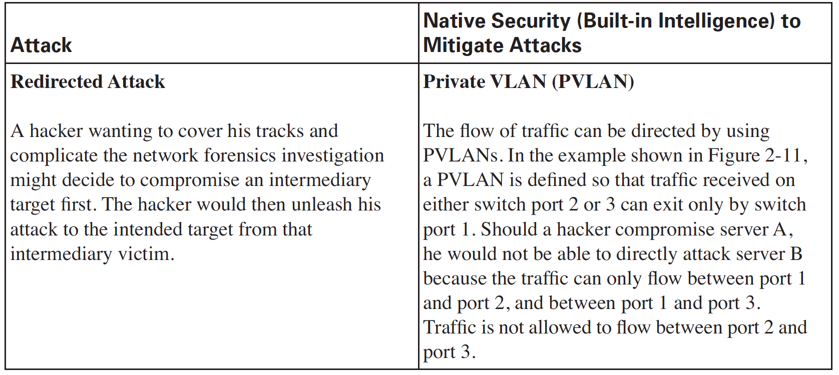
Catalyst Native Security

Slide 20
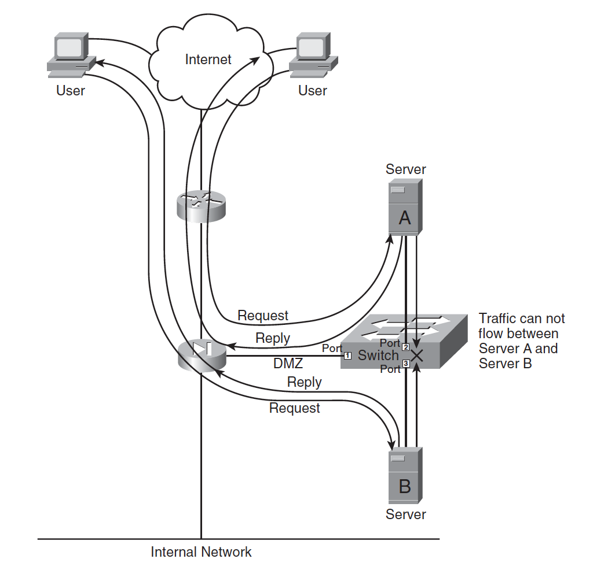

Slide 21
Catalyst Hardware Security
As an example, the Catalyst 6500 Series switches can be equipped with modules that are full-fledged security devices themselves.
Some example security modules are as follows:
Cisco Firewall service module
Cisco Internet Protocol security (IPsec) virtual private network (VPN) service module
Cisco Intrusion Detection System (IDS)
Cisco Secure Socket Layer (SSL)

Slide 22
Catalyst Hardware Security
As an example of the flexibility provided by these modules, consider that when using a Cisco Firewall service module, any port on a Catalyst 6500 switch can operate as a firewall.
An example of the expandability of the modules is the use of the IPsec VPN module.
This module can terminate up to 8000 VPN connections (known as VPN tunnels) simultaneously and can create 60 new tunnels per second; up to 10 of these modules can be installed in a Catalyst 6500 switch.

Slide 23
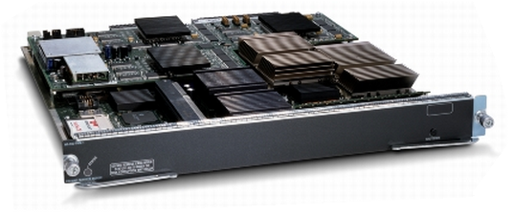
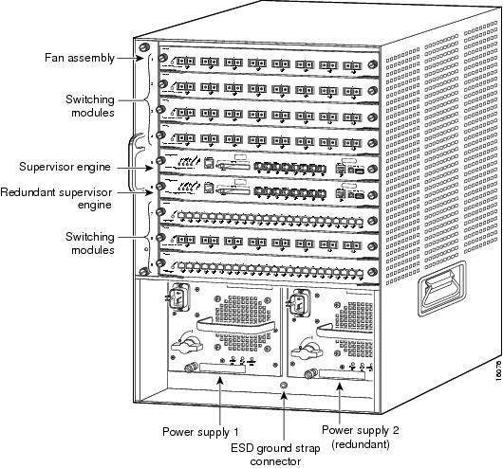
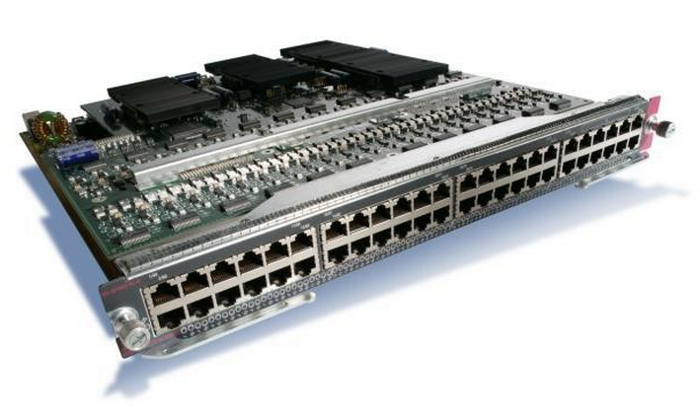
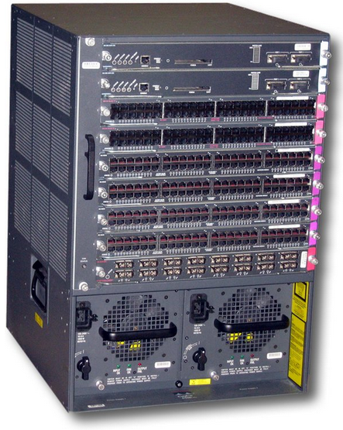

Slide 24
Switching Design Considerations
We Know:
the hierarchical network design model and
the Enterprise Composite Network Design model
Hierarchical ..: the access layer, the distribution layer, and the core layer
Enterprise Composite Network ..: Enterprise Campus, Enterprise Edge, and Service Provider Edge.
Each of these functional areas contains network modules, which in turn can include the hierarchical layers.

Slide 25
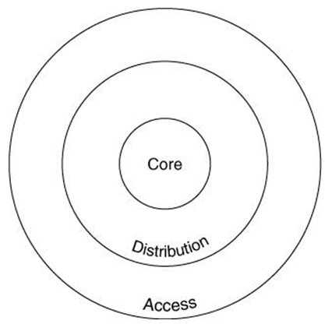
FOR THE ACCESS LAYER
For the access layer, design considerations include the following:
The number of end-user devices to be supported
The applications that are being used this defines some of the features required in the switches, as well as the performance and bandwidth needed
The use of VLANs, including whether trunks are required between switches
Redundancy requirements

Slide 26
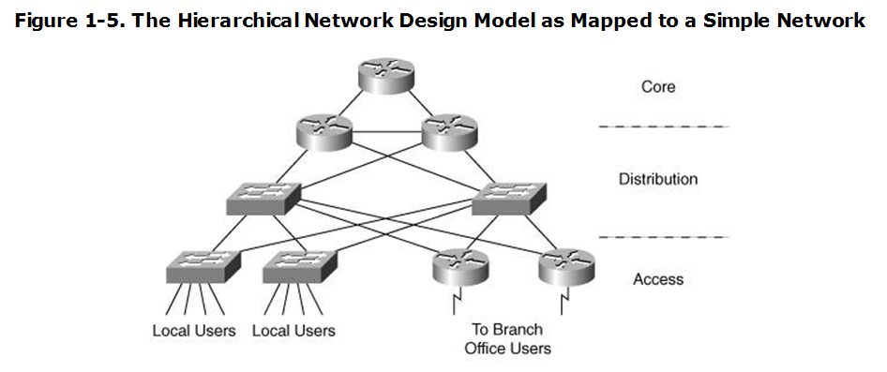
FOR THE DISTRIBUTION LAYER
For the distribution layer, design factors include the following:
The number of access switches to be aggregated
Redundancy requirements
Features required for specific applications to be supported
Required interfaces to the core layer
For Layer 3 switches, the routing protocols to be supported and whether sharing of information among multiple routing protocols is required

Slide 27
FOR THE CORE LAYER
The role of the core layer is to provide a high-speed backbone.
Thus, the key requirement is the performance needed to support all the access and distribution data.
The number of ports to the distribution layer, and the protocols (for example, routing protocols) that need to be supported on those ports, are also important considerations.
Redundancy in the core is a typical requirement, to meet the availability needs of the network

Slide 28

CISCO RECOMMENDATIONS
Cisco current campus design recommendations include the followin:
Layer 2 switches can be used at the access layer, with Layer 3 switches at the distribution and core layers.
VLANs should not spread across the campus, because this can slow network convergence.
The core and distribution layers can be combined into one layer (called a collapsed backbone) for smaller networks.
Larger campuses should have a separate distribution layer to allow the network to grow easily.
Redundancy in the core, between the core and distribution layers, and between the distribution and access layers is also recommended.

